Slide 1
Group 2
Ajinkya Tungare
Sumeet badgujar
Rutuja patole
Sharan rai
Shubham pandey

Slide 2
UNIRIDE
An e-bike commute system for university campuses

Slide 3

Problem Statement
Walking across the university campus from one location to another becomes tedious task as the campus is a very widespread area.
Students constantly need to travel from one location to another across campus, either for attending classes or for their job and this takes up lot of time and energy.

Slide 4

What is Uniride trying to solve?
To develop a platform that provides E-bike services to the users across the university campus.
To make travelling across the campus easier.
To save commuting time of students.

Slide 5
Stakeholders
Students enrolled in the university
Visitors to the university
E-bike providers

Slide 6

Scope
App based e-bike system
Registration using comet card/ NET ID and contact details.
E-bike navigation using real time GPS co-ordinates
Scan QR code present on the e-bike to unlock and start ride.
After parking at the destination, the e-bike will lock automatically.
The user will be charged for the e-bike ride based on the distance covered within the university campus.
E-wallet or one time payment method to pay for the ride.

Slide 7
Deliverables
Provide App Integrations for bike to customers
Leasing 250 bikes on the campus from company
QR code-based bike lock/unlock.
Dedicated Charging Stations around the campus.
Dedicated parking spaces around each campus building
On campus e-bike maintenance

Slide 8

Acceptance criteria
Daily 1000 rides around campus.
Minimum 30% of Students have used this service at least 1 time in a month

Slide 9
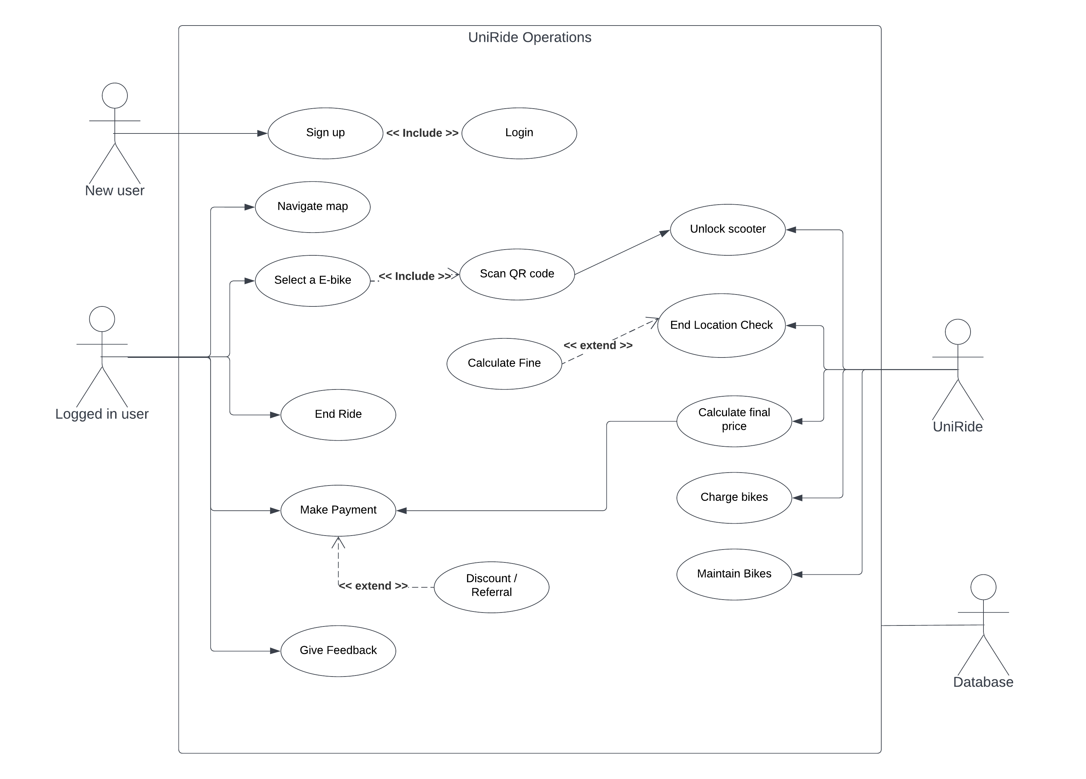
Use case diagram

Slide 10
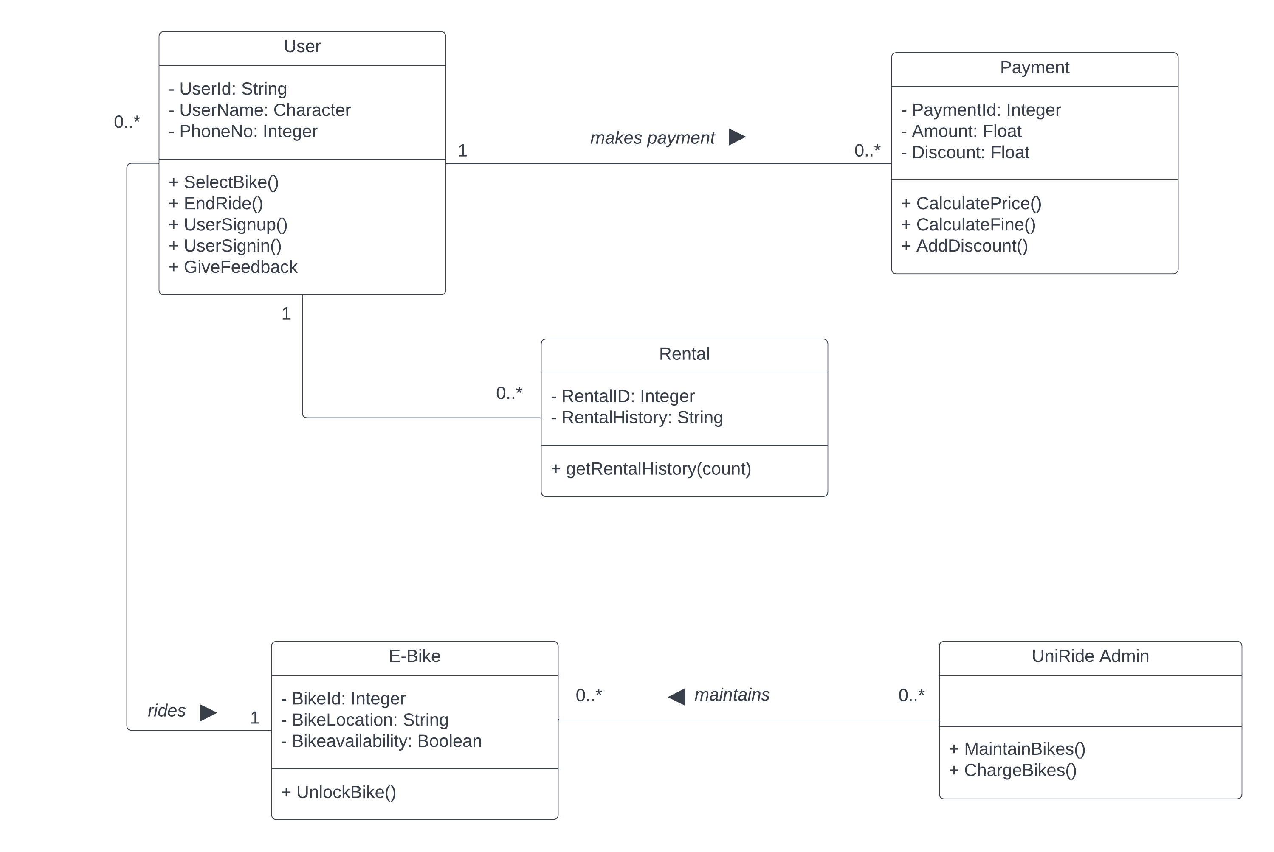
Class diagram

Slide 11
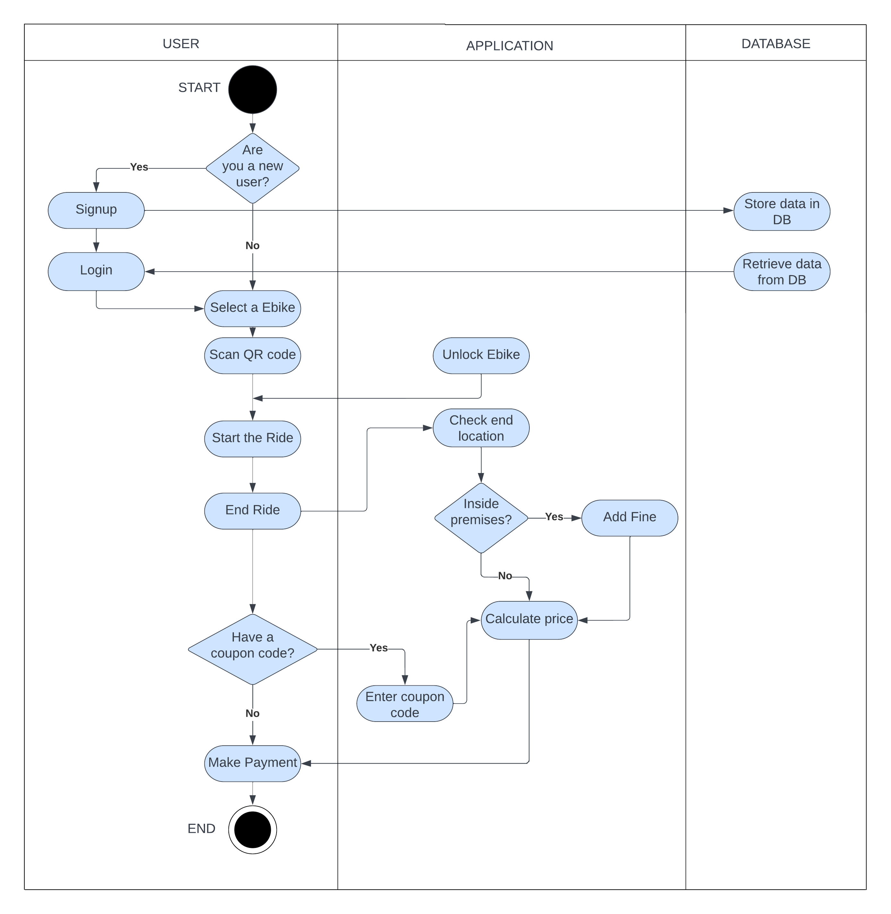
Activity flow diagram

Slide 12

Work Breakdown Structure
I. Project Planning:
Develop WBS and build schedule and then plan the work – 1/2 day.
II. Analysis tasks:
· Meet with the UTD transportation department – 1 day
· Meet with the UI team – 1 day
· Define the required data elements and share with the development team – 1 day
· Model user activities – 2 day
III. Design tasks:
· Design database schema and share with the development team – 1 day
· Design UI elements and features – 2 days
· Identify program classes and methods – 1 day
IV. Build tasks:
· Build database schema – 1 day
· Write program code – 5 days
· Build test data – 1 day
· Perform Quality Assurance tests – 2 days
· Perform application performance testing – 1 day
· Perform user acceptance tests with user – 1 day
· Release accepted version – 1 day

Slide 13
Thankyou

